Slide 1

Milestone 2
8 / 14
APPLICATION-LAYER ATTACK MODULE IMPLEMENTATION
The ESP32 Wi-Fi firmware is closed-source binary, so attacks are emulated at the application layer using normal esp_mesh_send / esp_mesh_recv calls (no raw 802.11 frames are touched).
Blackhole attack — what it does:
  A single attacker node positioned to receive probe traffic from victims.
  Victims address probes directly to the attacker's MAC (behavioral equivalent of a false short-route advertisement).
    Baseline / cooldown phases: attacker forwards probes normally to root.
    Attack phase: attacker silently stops calling esp_mesh_send — packets vanish.
  Observable signature: zero forwarded probes reach the root during the attack window.
Wormhole attack — what it does:
  Two attacker nodes: Attacker B placed near victims, Attacker A placed near root.
  A wired UART link between A and B acts as the out-of-band tunnel (this is what makes it a wormhole rather than ordinary forwarding).
    Attacker B captures probe metadata from local mesh traffic during the attack phase.
    Metadata is shipped through UART to Attacker A; CRC-protected to detect errors.
    Attacker A reconstructs a replica probe and re-injects it toward root via the legitimate mesh path.
  Observable signature: the same logical probe arrives at root twice — once via slow multi-hop, once via fast wormhole shortcut, with a measurable latency mismatch.
Criteria:
  Blackhole: root logs show the expected drop in arrivals during the attack window and normal arrivals before and after.
  Wormhole: root logs show duplicate probe arrivals with measurable latency difference during the attack window.
  Both attacks toggle cleanly on phase transitions; no leakage into baseline windows.
  Behavior is consistent across all four topologies

Slide 2
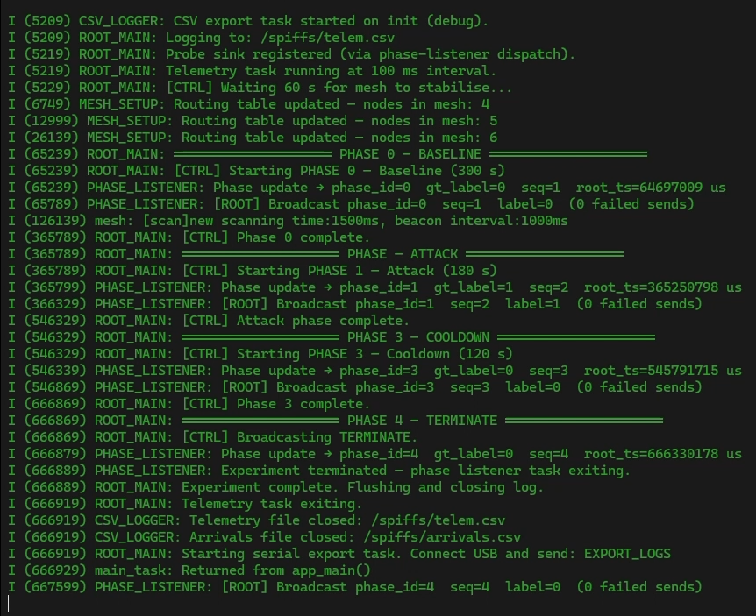
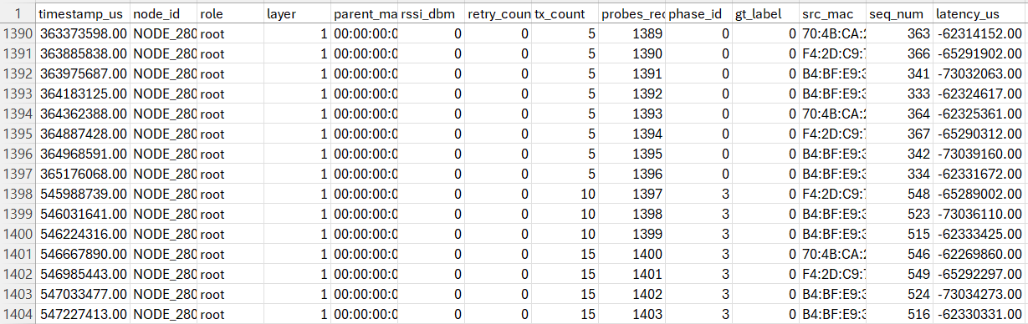
Milestone 2
8 / 14
APPLICATION-LAYER ATTACK MODULE IMPLEMENTATION
(source: Linear Topology - Blackhole)

Slide 3
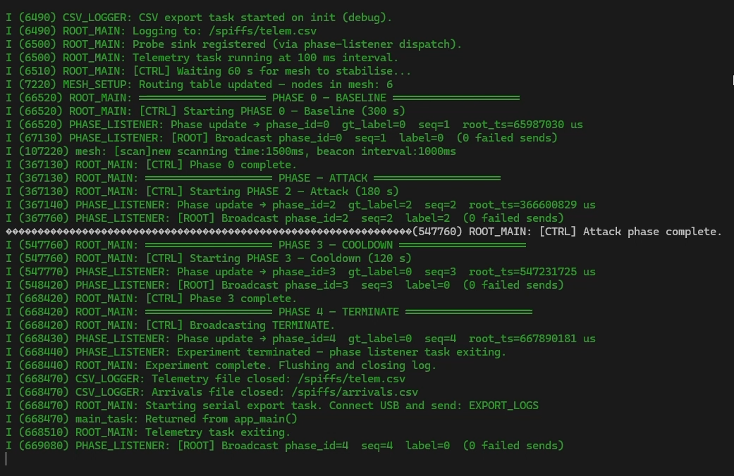
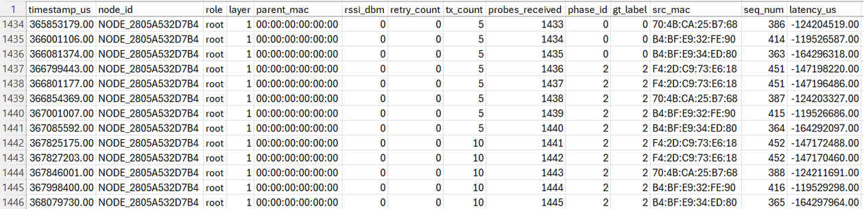
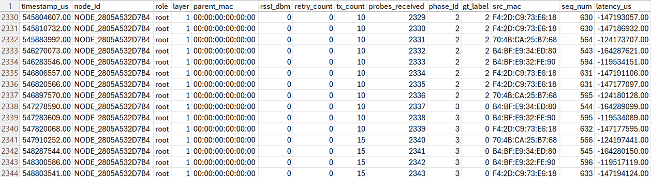
Milestone 2
8 / 14
APPLICATION-LAYER ATTACK MODULE IMPLEMENTATION
(source: Linear Topology - Wormhole)

Slide 4
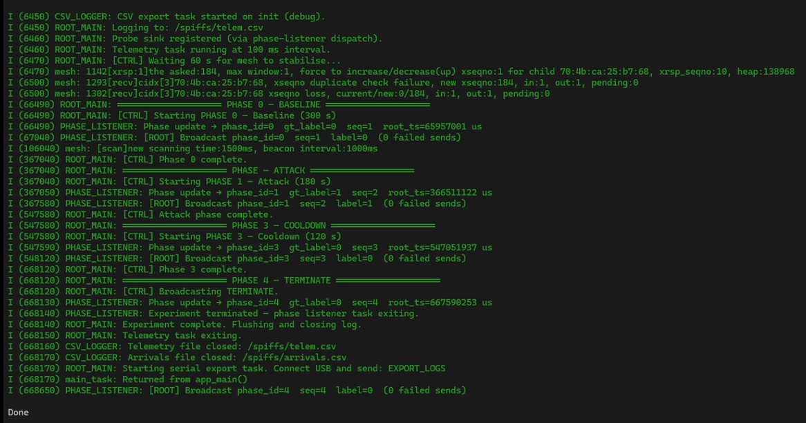
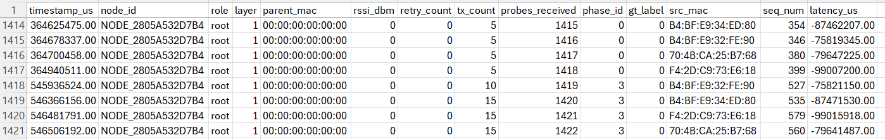
Milestone 2
8 / 14
APPLICATION-LAYER ATTACK MODULE IMPLEMENTATION
(source: Star Topology - Blackhole)

Slide 5
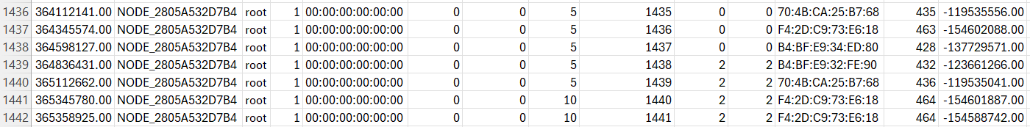
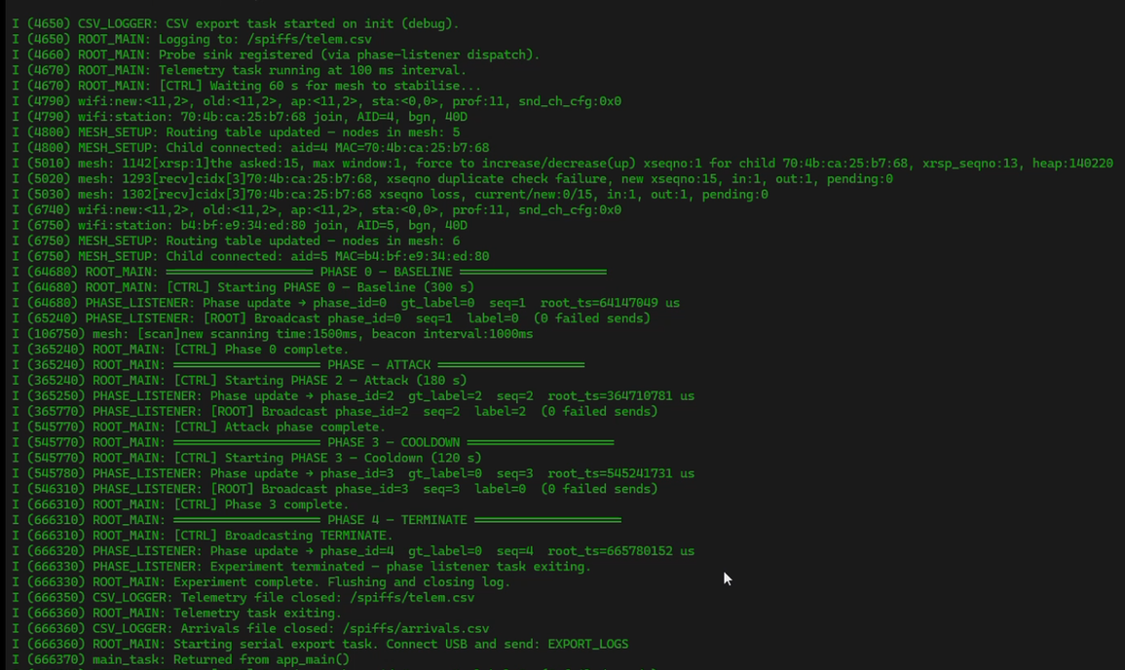
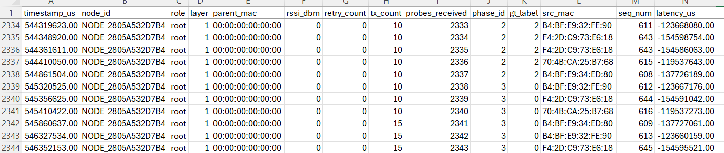
Milestone 2
8 / 14
APPLICATION-LAYER ATTACK MODULE IMPLEMENTATION
(source: Star Topology - Wormhole)

Slide 6
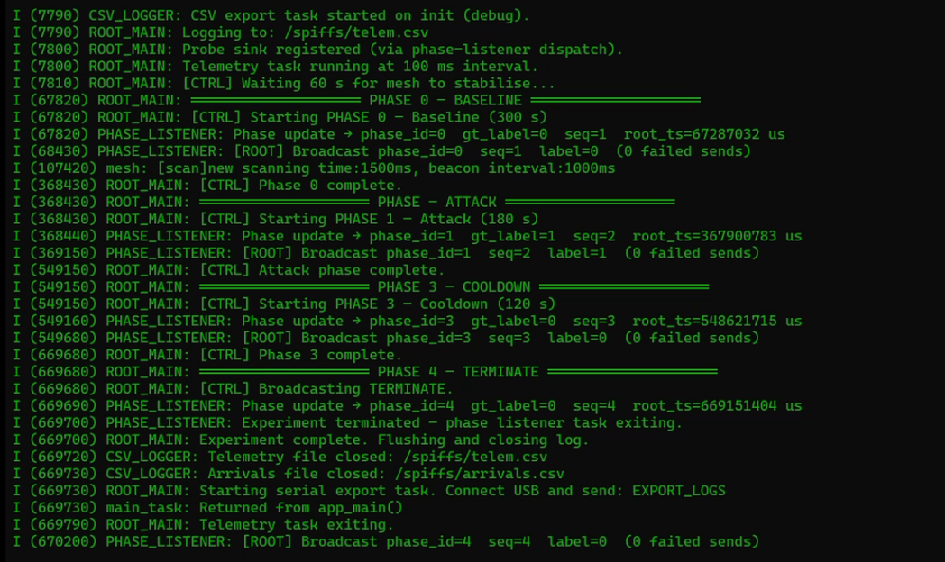
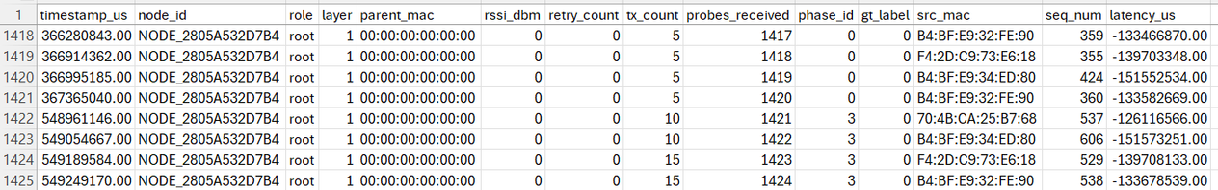
Milestone 2
8 / 14
APPLICATION-LAYER ATTACK MODULE IMPLEMENTATION
(source: Tree Topology - Blackhole)

Slide 7

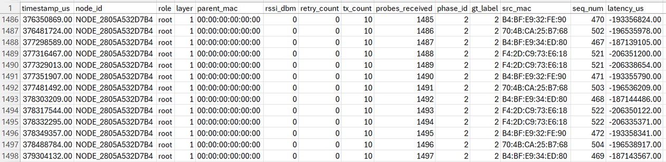
Milestone 2
8 / 14
APPLICATION-LAYER ATTACK MODULE IMPLEMENTATION
(source: Tree Topology - Wormhole)

Slide 8
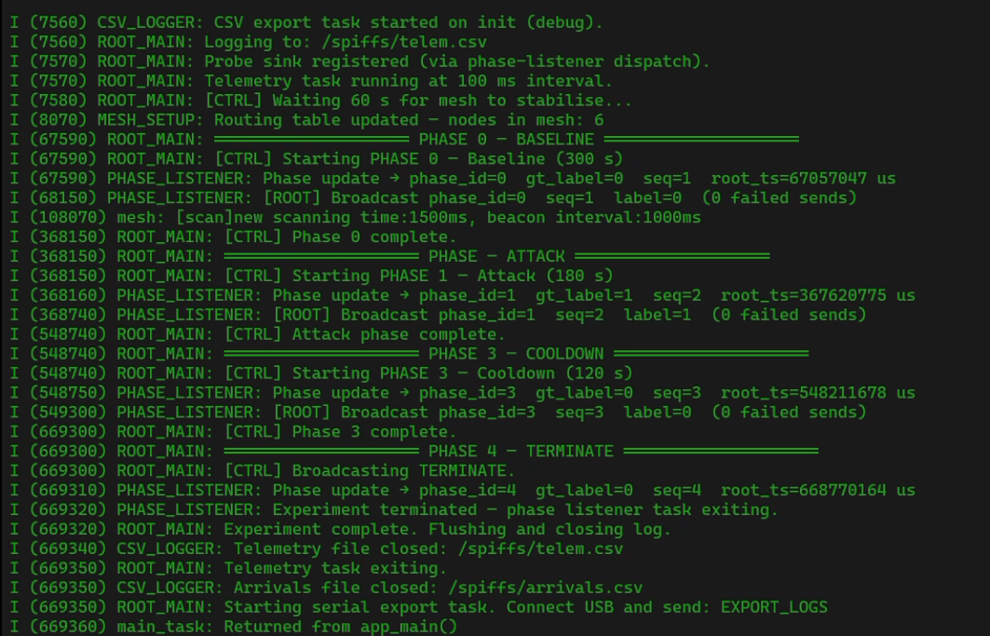
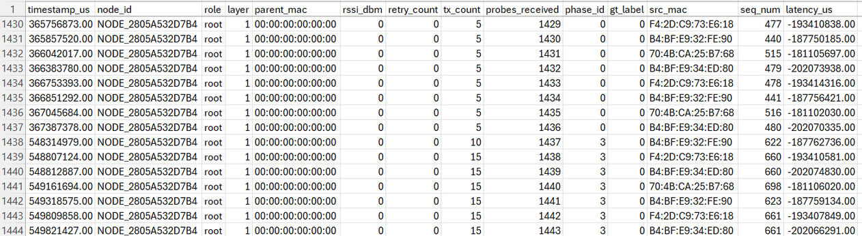
Milestone 2
8 / 14
APPLICATION-LAYER ATTACK MODULE IMPLEMENTATION
(source: Partial Mesh Topology - Blackhole)

Slide 9
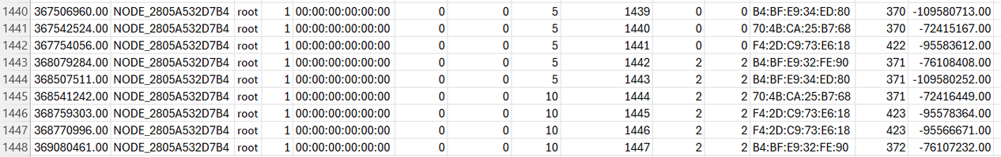
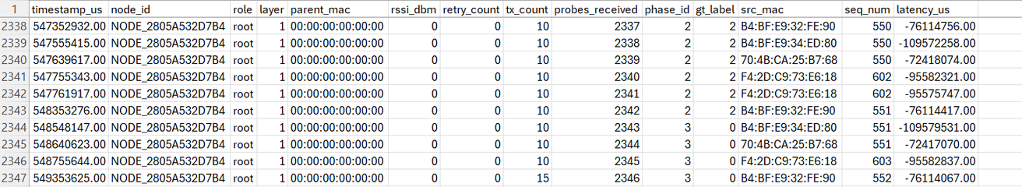
Milestone 2
8 / 14
APPLICATION-LAYER ATTACK MODULE IMPLEMENTATION
(source: Partial Mesh - Wormhole)

Slide 10
Milestone 3
8 / 14
MULTI-TOPOLOGY TESTBED DEPLOYMENT
Physically deploy and verify the mesh in all four topology configurations from the proposal.
Topologies to deploy:
  Star — every node connects directly to the root (single-hop tree).
  Tree — hierarchical structure with intermediate forwarding nodes.
  Linear chain — nodes arranged in a line; each reaches only adjacent neighbors (forces long multi-hop paths).
  Partial mesh — some nodes have multiple potential parents (most realistic for real-world deployments).
Setup constraints:
  5 to 10 ESP32 nodes, positions fixed and documented per topology.
Criteria:
  Each topology converges to its intended parent-child structure within 60 seconds.
  Structure is verified by inspecting parent-MAC and layer values in root logs.
  Mesh remains stable through a full 5-minute baseline phase (no spontaneous re-routing).
  Both attacks show their expected signatures in all four topologies.

Slide 11
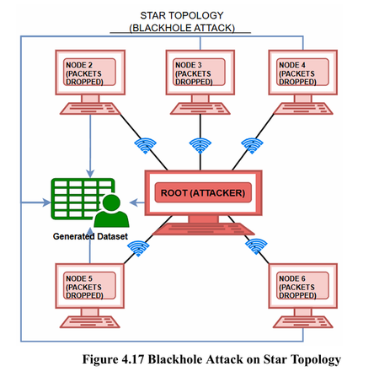
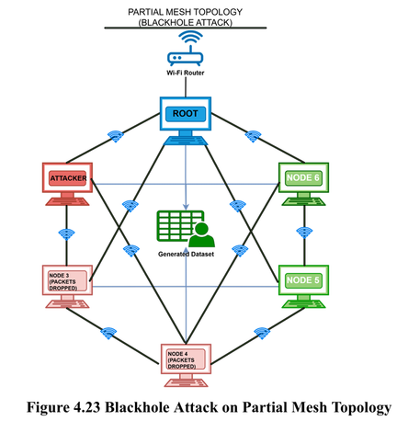
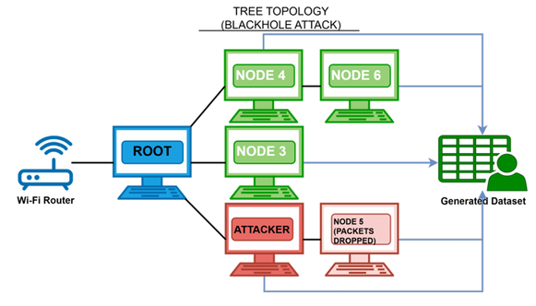
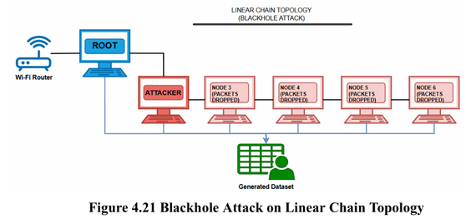
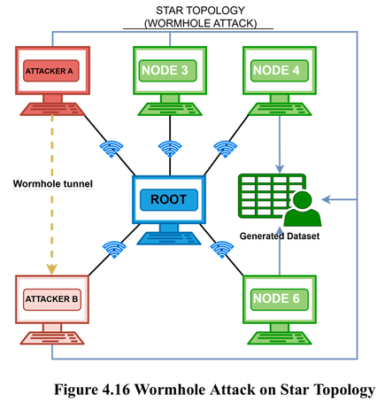
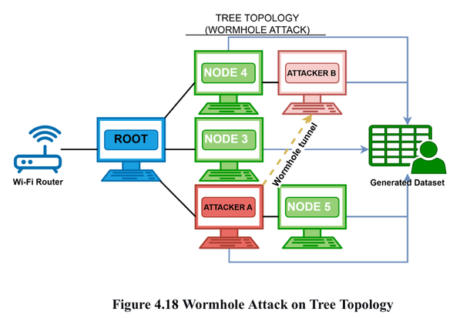
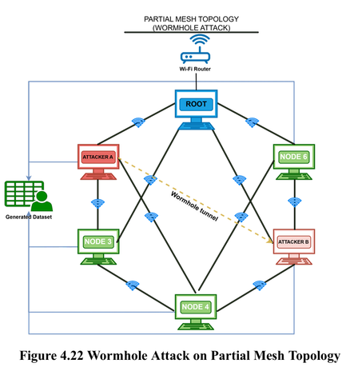
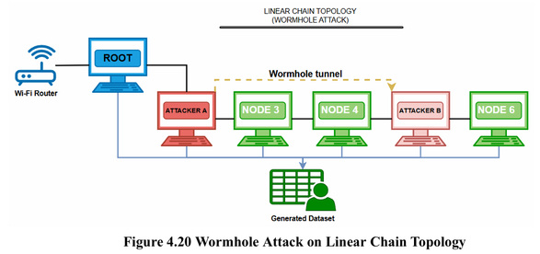
Milestone 3
8 / 14
MULTI-TOPOLOGY TESTBED DEPLOYMENT
Blackhole
Wormhole

Slide 12
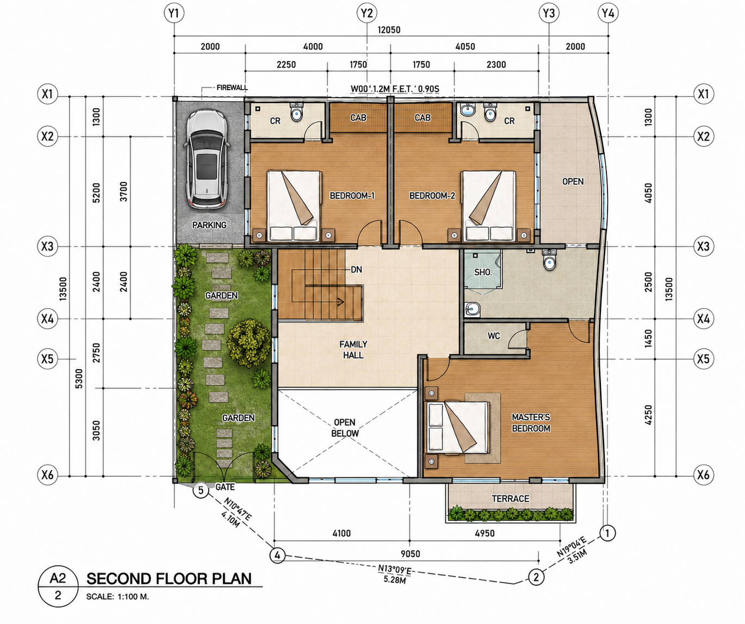
BASELINE
NODE
2
NODE 5
NODE 6
ROOT
NODE 4
NODE
3

Slide 13
BLACKHOLE
  LINEAR
  PARTIAL MESH
  TREE
NODE
2
NODE 5
NODE 6
ROOT
NODE 4
NODE
3

Slide 14
BLACKHOLE
STAR
NODE
5
NODE
2
NODE
6
NODE 6
NODE
3
ROOT
NODE 4

Slide 15
WORMHOLE
  LINEAR
  PARTIAL MESH
  TREE
NODE
2
NODE 5
NODE 6
ROOT
NODE 6
NODE 4
NODE
3

Slide 16
WORMHOLE
STAR
NODE 5
NODE
2
NODE 6
NODE
3
ROOT
NODE 4

Slide 17
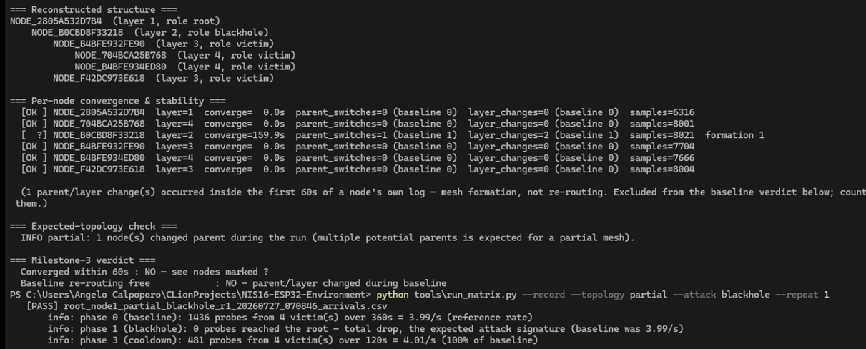
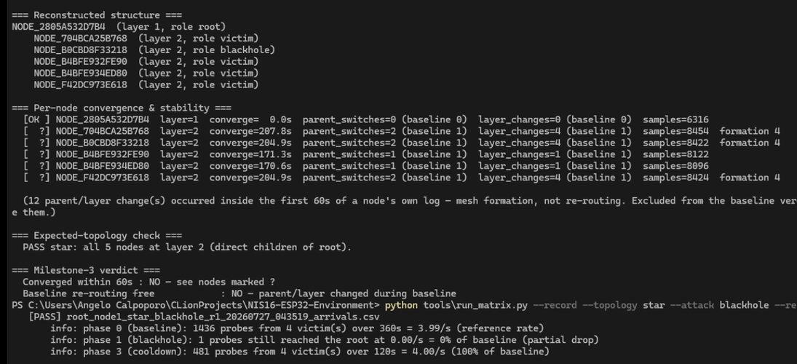
Milestone 3
8 / 14
MULTI-TOPOLOGY TESTBED DEPLOYMENT
(source: Partial Mesh Topology - Blackhole)
(source: Star Topology - Blackhole)
  Each topology converges to its intended parent-child structure within 60 seconds.
  Structure is verified by inspecting parent-MAC and layer values in root logs.
  Mesh remains stable through a full 5-minute baseline phase (no spontaneous re-routing).
  Both attacks show their expected signatures in all four topologies.

Slide 18
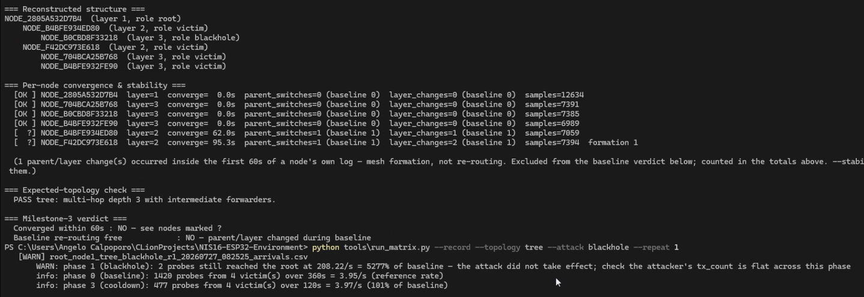
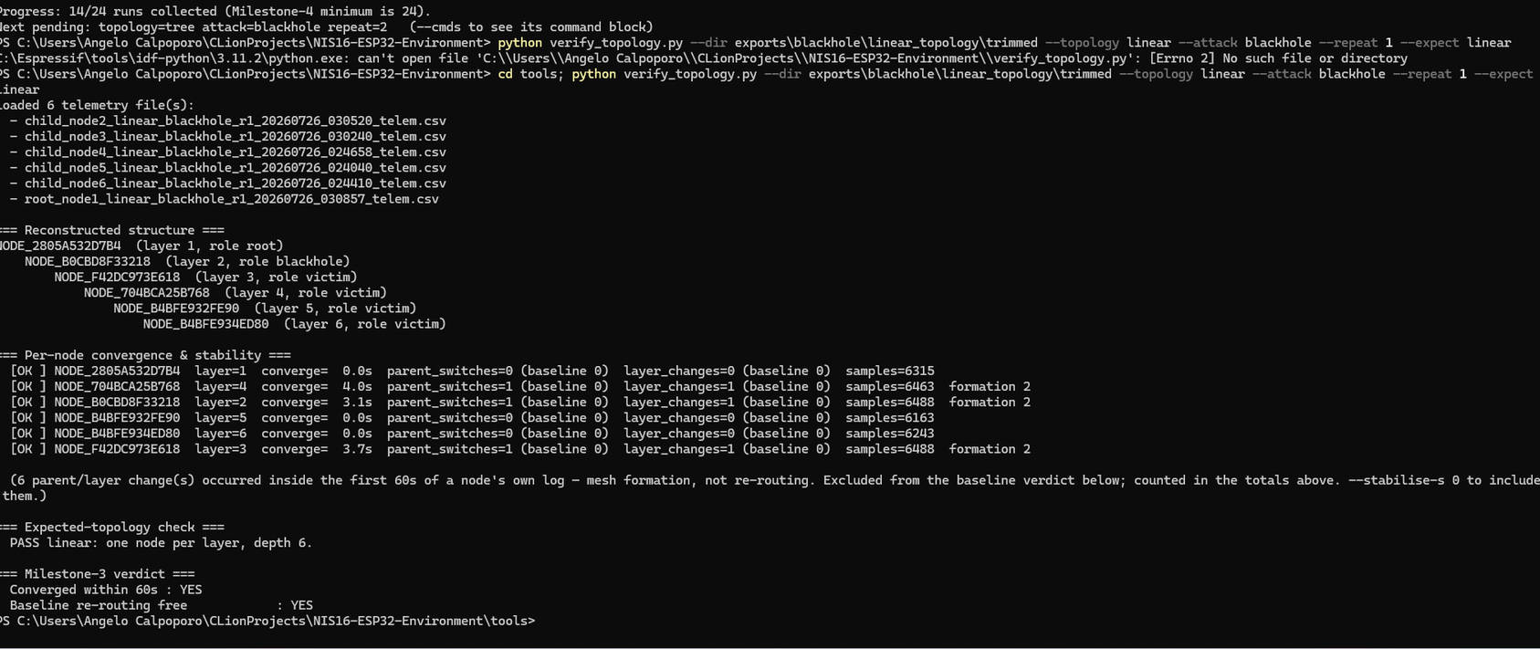
Milestone 3
8 / 14
MULTI-TOPOLOGY TESTBED DEPLOYMENT
(source: Tree Topology - Blackhole)
(source: Linear Topology - Blackhole)

Slide 19
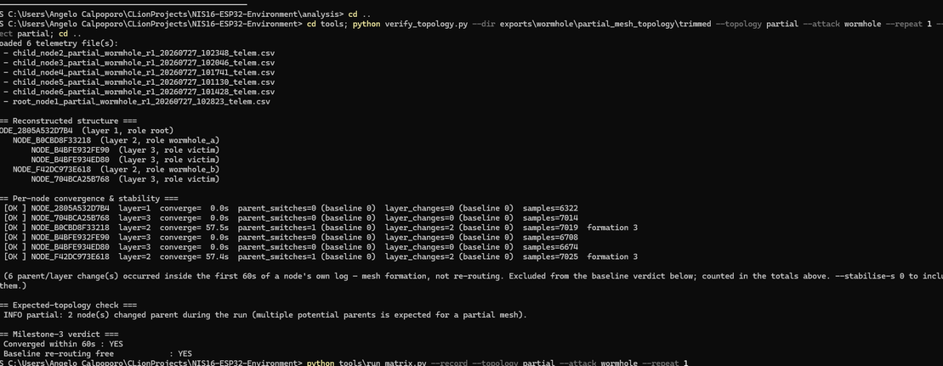
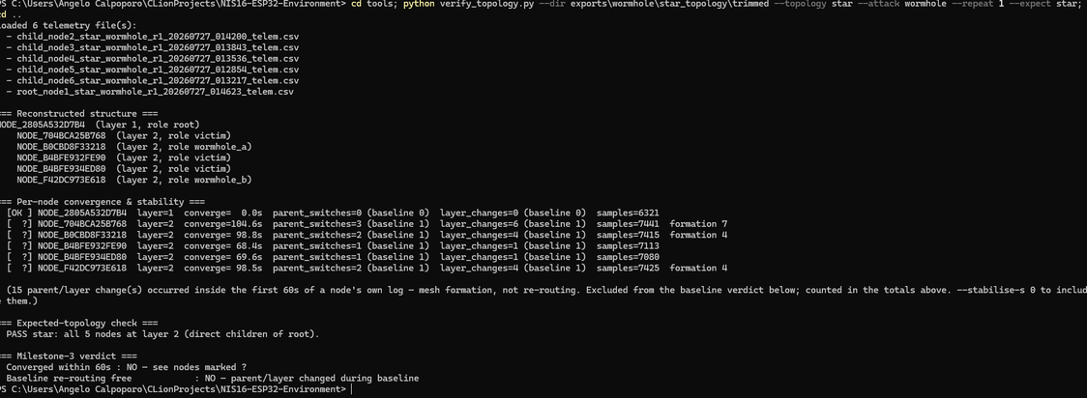
Milestone 3
8 / 14
MULTI-TOPOLOGY TESTBED DEPLOYMENT
(source: Partial Mesh Topology - Wormhole)
(source: Star Topology - Wormhole)

Slide 20
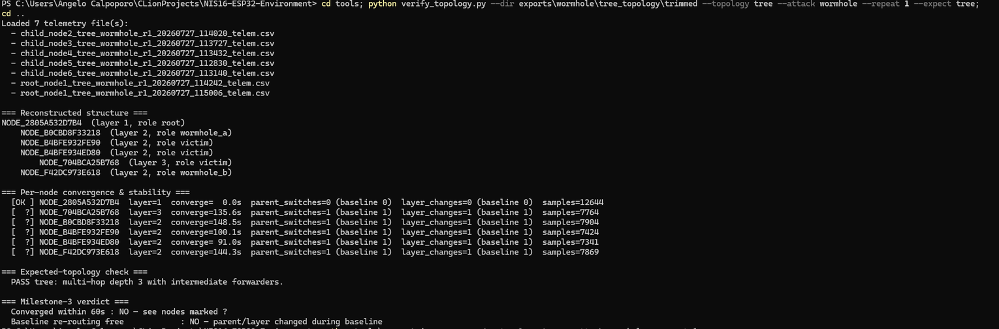
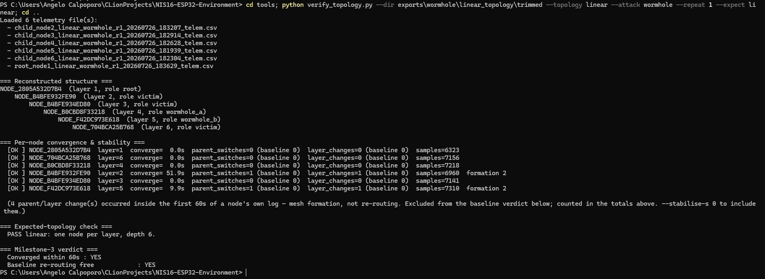
Milestone 3
8 / 14
MULTI-TOPOLOGY TESTBED DEPLOYMENT
(source: Tree Topology - Wormhole)
(source: Linear Topology - Wormhole)

Slide 21
Milestone 4
8 / 14
PHASE-CONTROLLED EXPERIMENT EXECUTION
Run the full experimental matrix and produce labeled raw telemetry per run.
Run timeline (per experiment):
  1 minute — mesh formation.
  5 minutes — baseline (normal operation).
  3 minutes — attack phase active.
  2 minutes — cooldown.
Experimental matrix:
  4 topologies × 2 attack types × at least 3 repeats = minimum 24 runs.
  Root broadcasts phase transition signals; every node embeds the current phase ID in its log rows (the ground-truth label).
Criteria:
  At least 24 complete runs are collected.
  Every run's per-node CSV logs are intact.
Phase IDs in node logs match the root's broadcast timeline within tolerance.

Slide 22
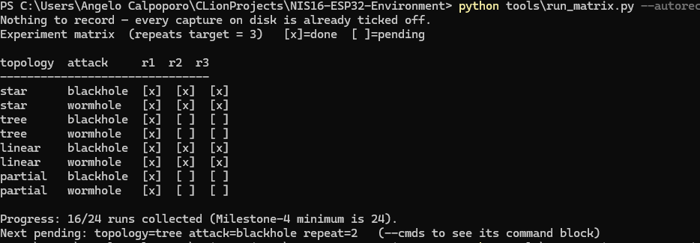
Milestone 4
8 / 14
PHASE-CONTROLLED EXPERIMENT EXECUTION
  At least 24 complete runs are collected.

Slide 23
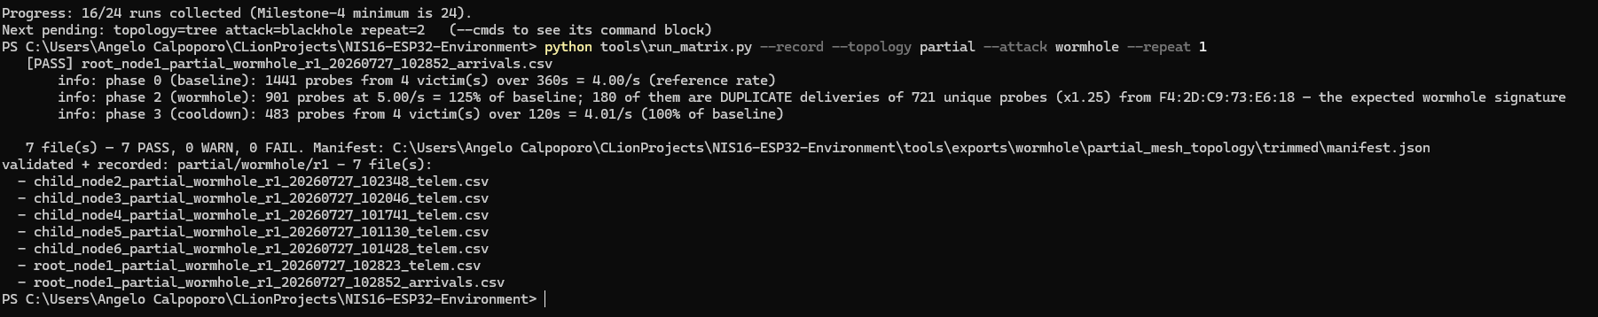
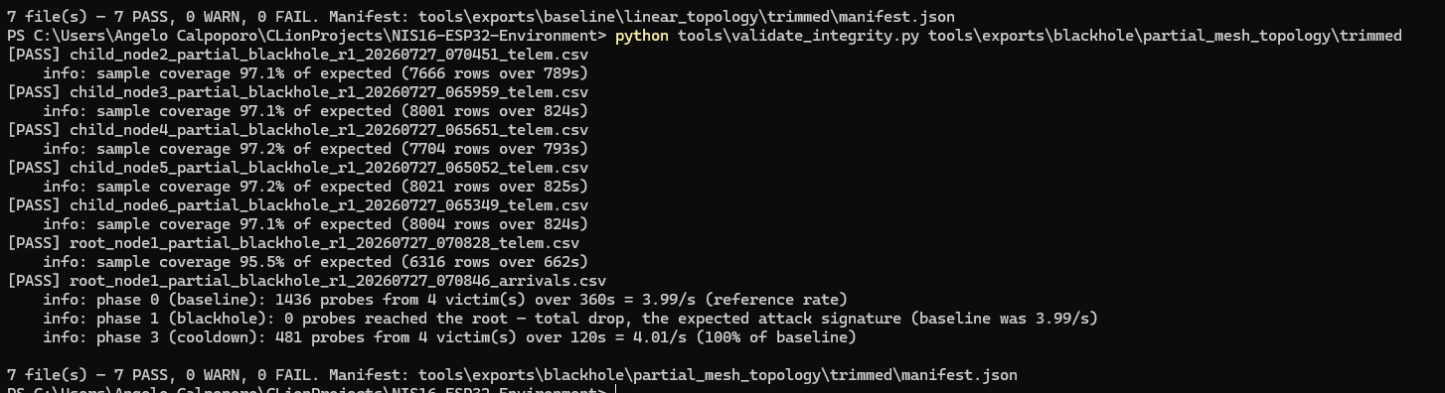
Milestone 4
8 / 14
PHASE-CONTROLLED EXPERIMENT EXECUTION
Every run's per-node CSV logs are intact.
Each run produces 7 files — 5 child telemetry + root telemetry + root arrivals — and each passes five checks before the run counts.

